Slide 1


Group 3
Program Output
Programming Java NCIII -
System Development

Slide 2


Student Management System

Slide 3

A Program (Java) NCIII Program Presented to:
Jareth Ronquillo
(Trainer)
Joysis Tech Voc Inc
(School)
No.1 Inda Maria Rd. Potrero, Malabon City 1475
(Address)

Slide 4

In Partial Fulfilment of the Requirements for the Course Java
Programming NCIII
Submitted by:
Aquino, Crystal Kate
Balle, Kristian Irish
Bobis, Mark Luiz
Magno, Prince Kiej
Simara, Daniella Mercurio
Simms, Paul Marius

Slide 5
The Team
Aquino, Crystal Kate
Balle, Kristian Irish
Bobis, Mark Luiz
Magno, Prince Kiej
Simara, Daniella Mercurio
Simms, Paul Marius

Slide 6

Introduction
Managing student profiles and academic data can be overwhelming for institutions. Our Student Management System (SMS) aims to automate and simplify these tasks, ensuring up-to-date, accurate information and smoother operations. The system focuses on the functionalities like student profile management, subject and course handling, and scheduling.

Slide 7

Objective of the Project
Automate data management
Optimize Data Accuracy
Streamline scheduling
Improve administrative efficiency
Automate student profile management to reduce manual work.
Improve the accuracy and accessibility of student data.
Simplify academic operations like scheduling and course enrollment.
Enhance overall administrative efficiency within educational institutions.

Slide 8




Target Market
Educational Institutions: Schools, colleges, and universities looking to automate student data management, course registration, and scheduling processes.
2. Online Learning Platforms: E-learning providers seeking efficient ways to manage student enrollments and track academic progress.
3. Vocational and Training Centers: Organizations that offer short-term courses or skill-based training, requiring efficient student data and schedule management.

Slide 9
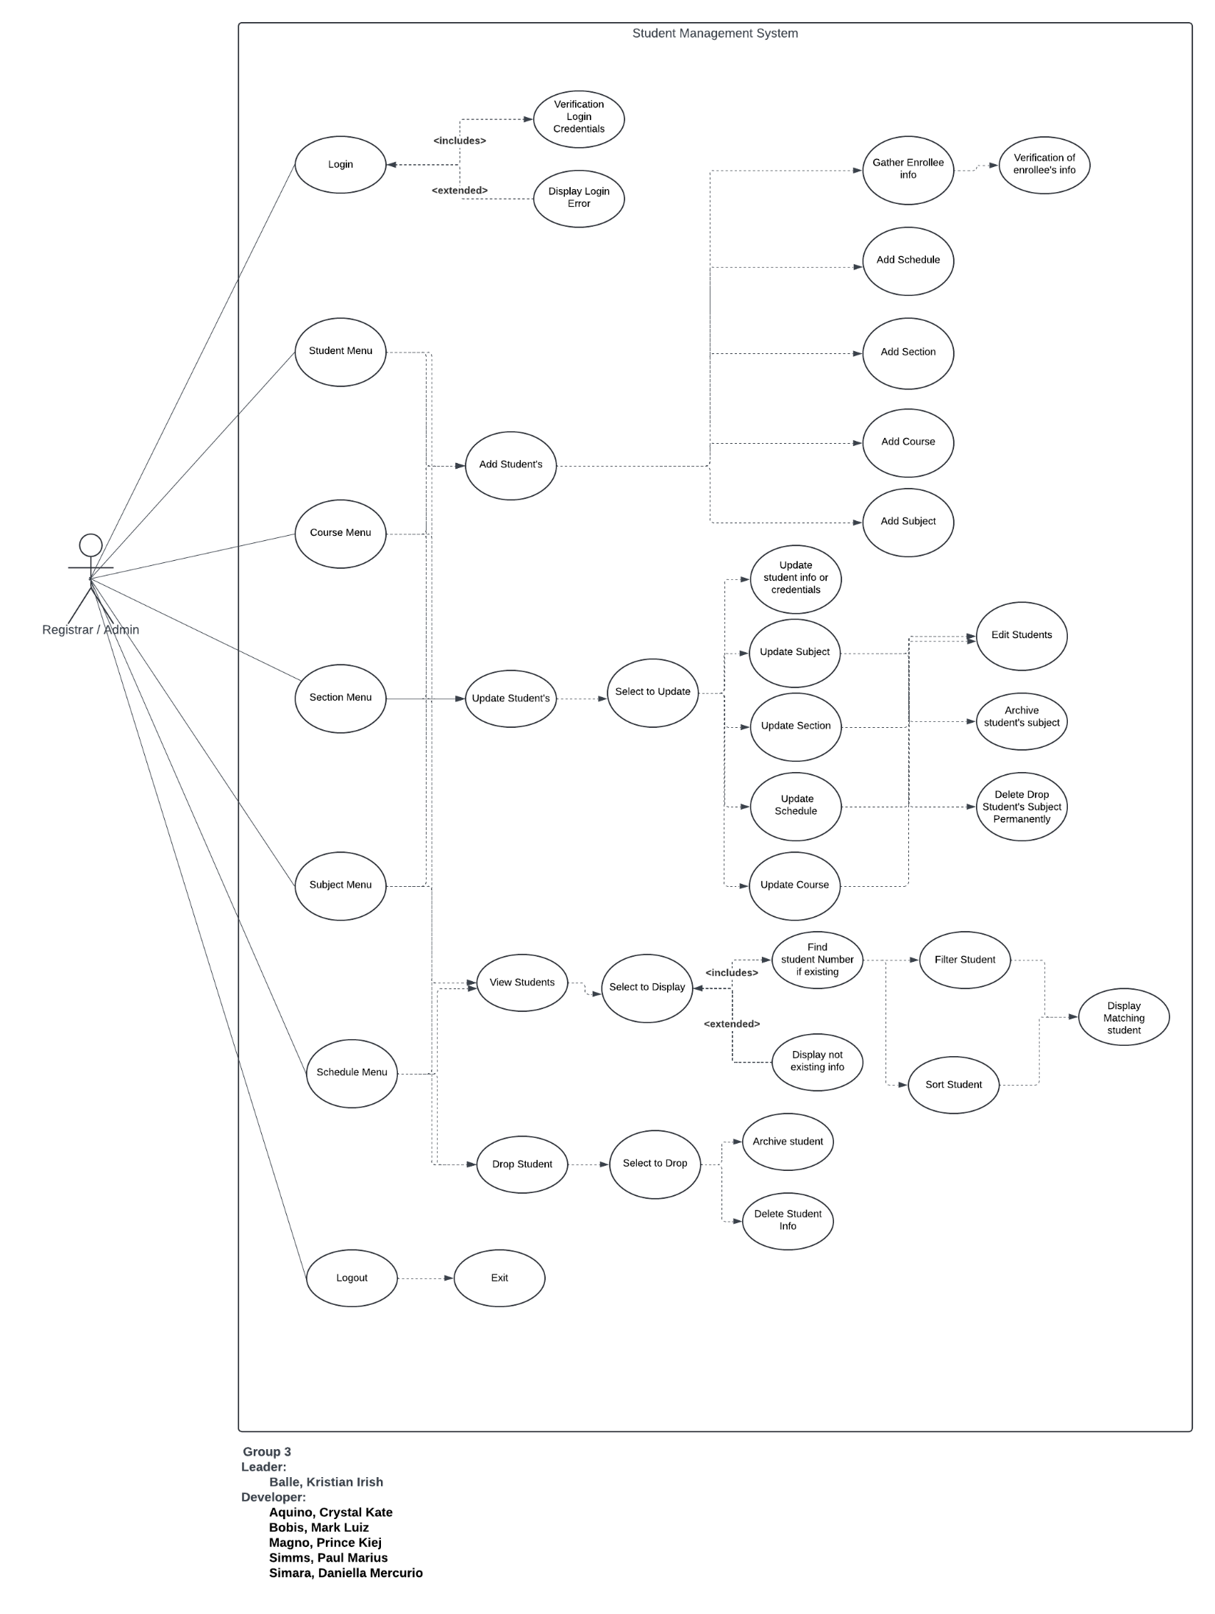


Use Case Diagram

Slide 10
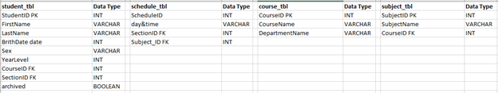
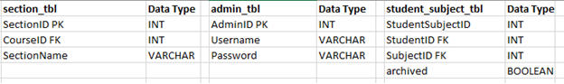
Database Outline

Slide 11
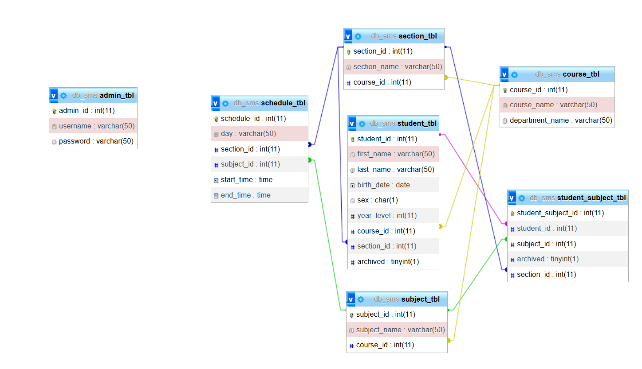
Database Design and Table Design

Slide 12
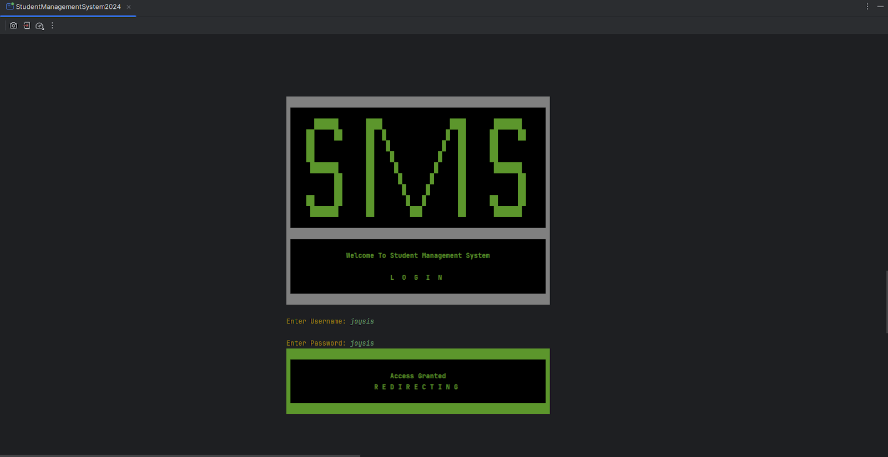
Program Photos
Login

Slide 13
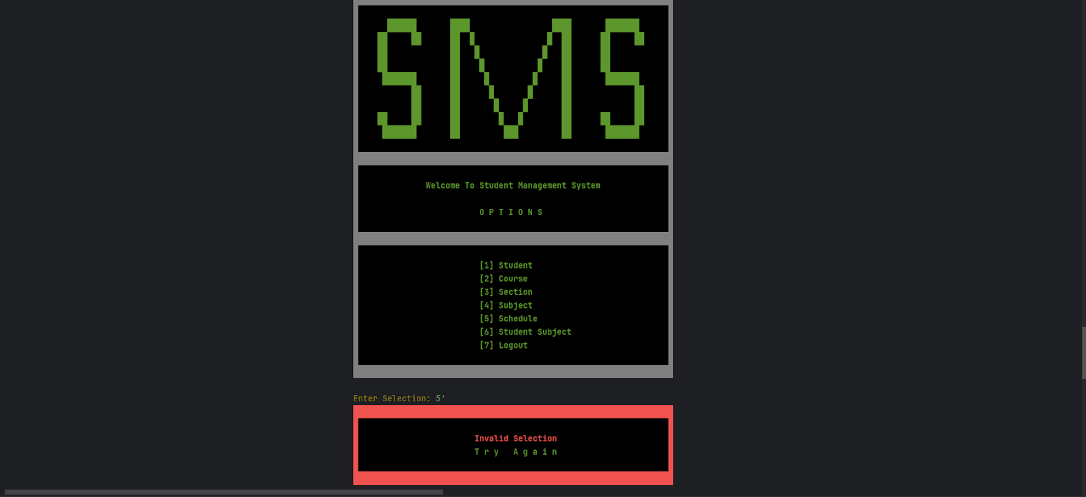
Program Photos
Main Menu

Slide 14
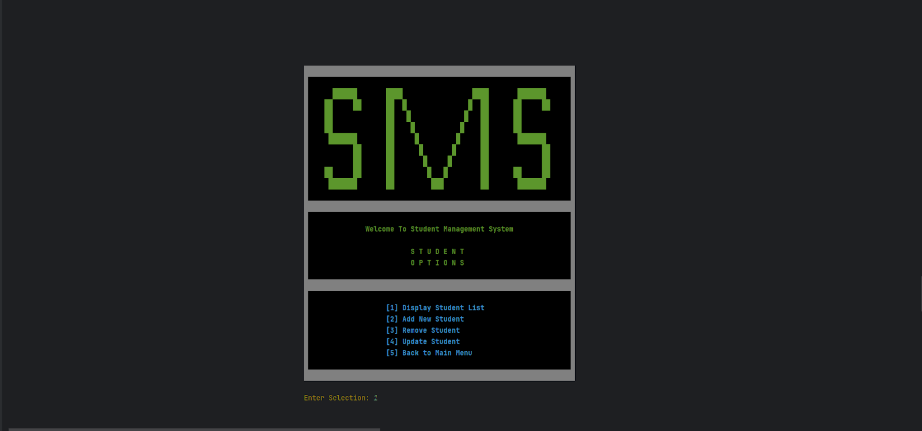
Program Photos
Student Menu

Slide 15
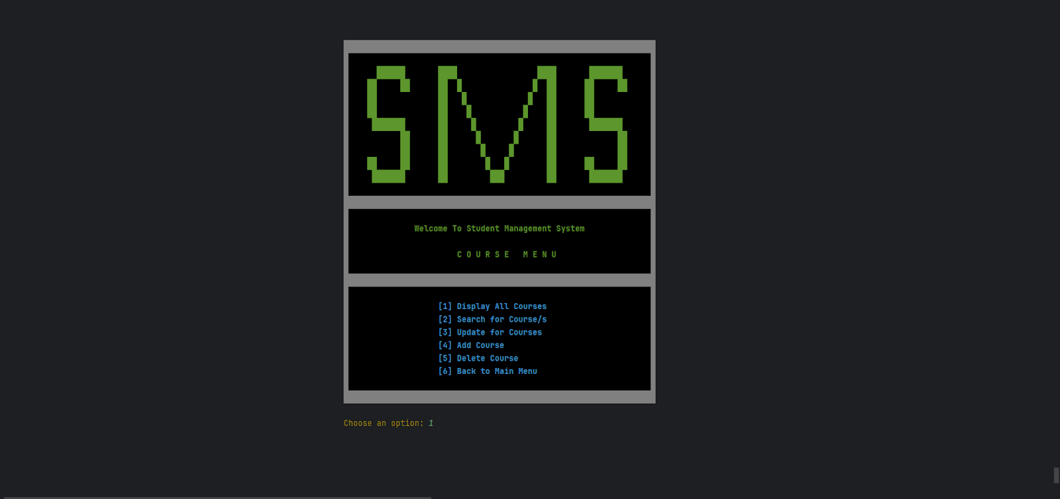
Program Photos
Course Menu

Slide 16

Program Photos
Section Menu

Slide 17
Program Photos
Menu

Slide 18
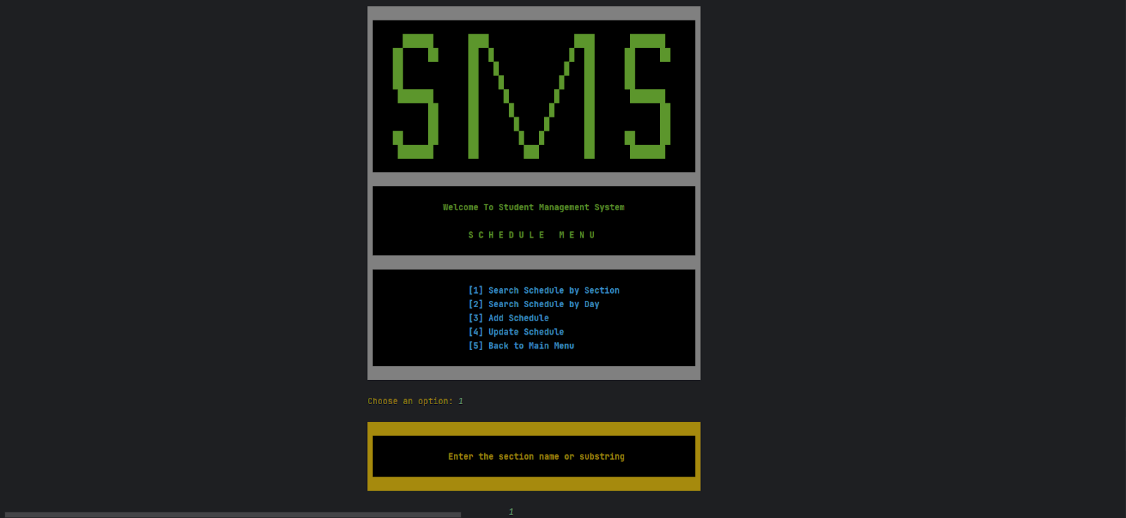
Program Photos
Schedule Menu

Slide 19
Program Photos
Student Subject Menu

Slide 20
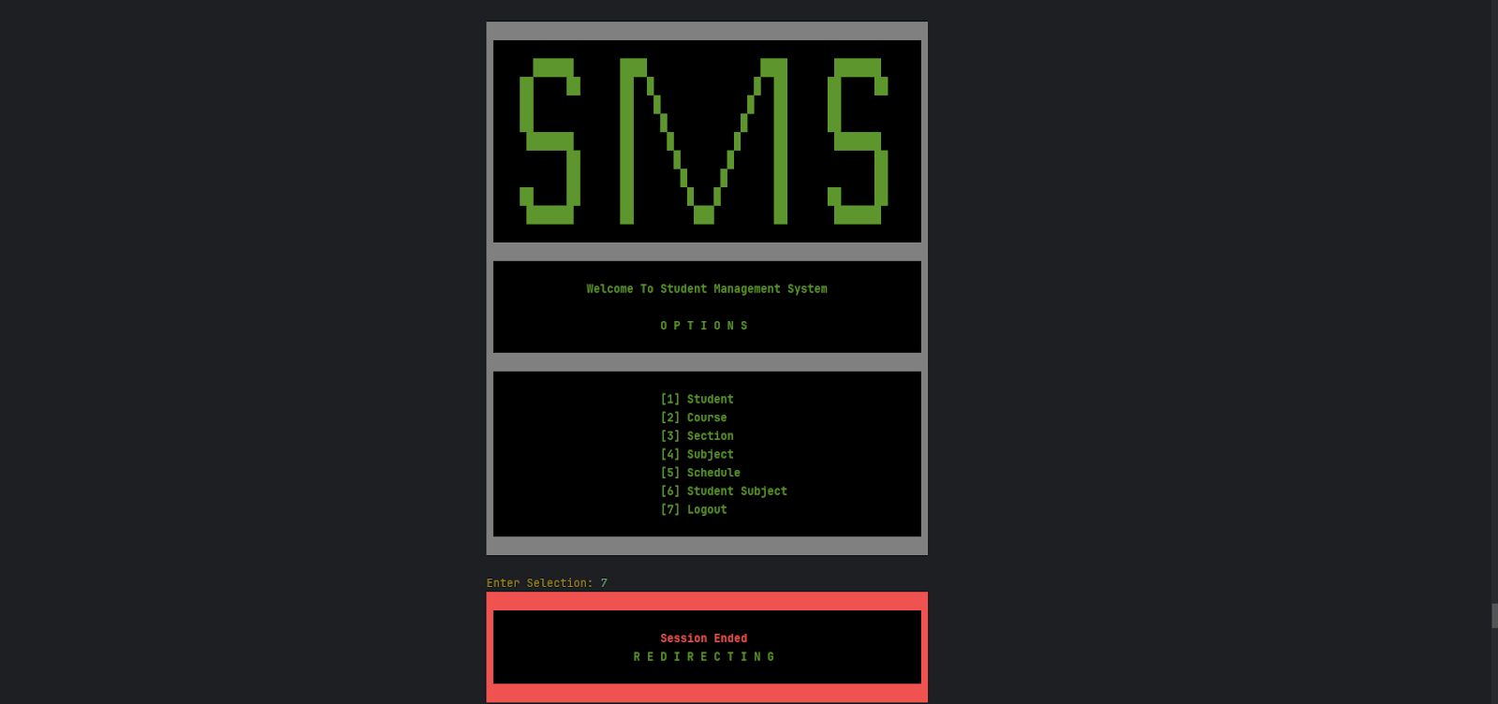
Program Photos
Logout

Slide 21
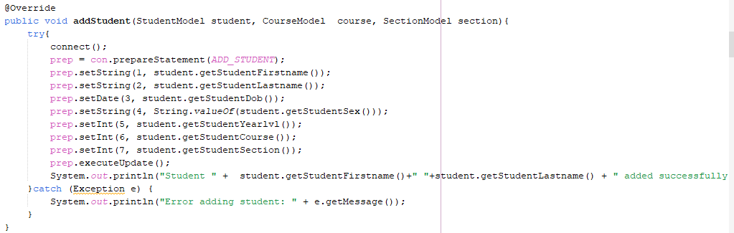
Source Code
Add Student

Slide 22
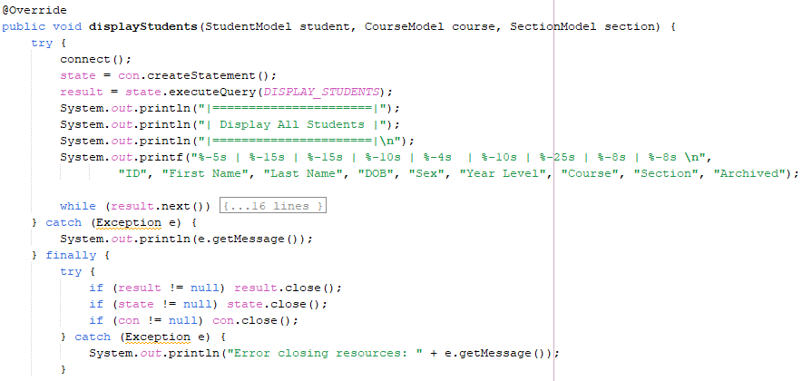
Source Code
Display / View Student

Slide 23
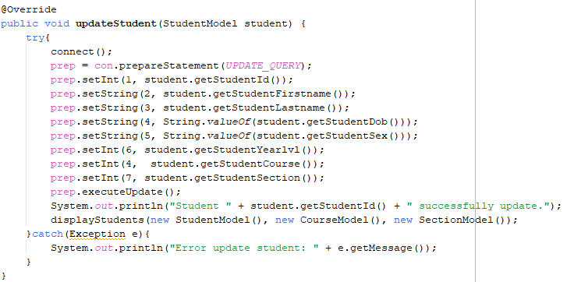
Source Code
Update Student

Slide 24
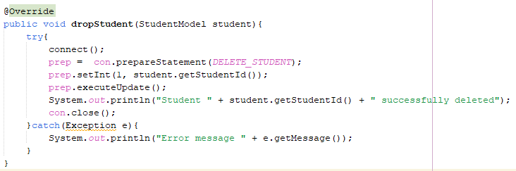
Source Code
Drop / Delete Student

Slide 25
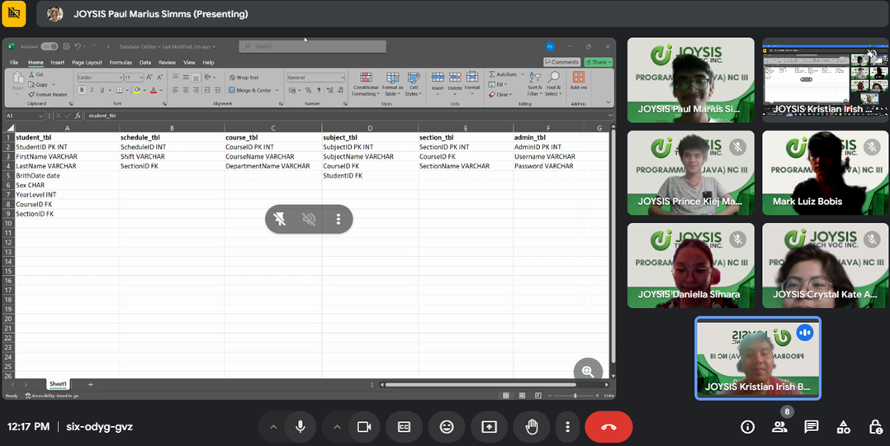
Daily Captured Work Progress
Day 1
Collaboration for our Use - Case Diagram

Slide 26
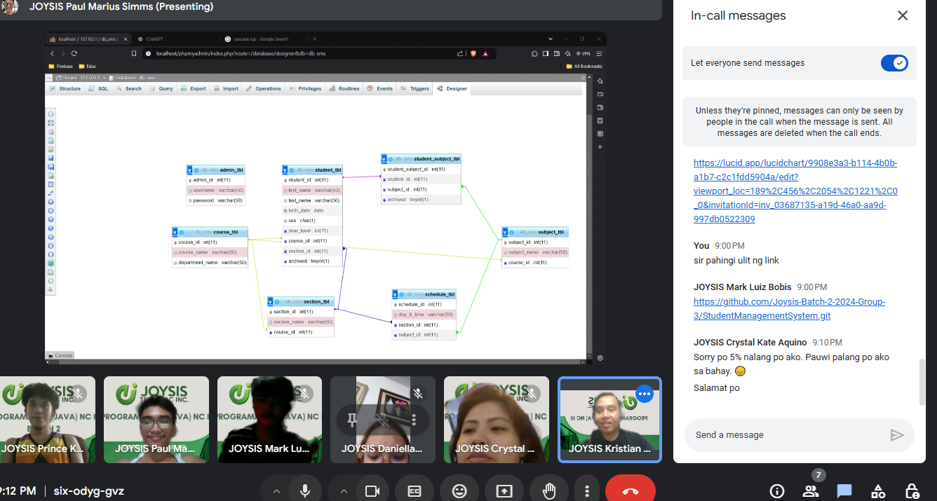
Daily Captured Work Progress
Day 2
Use Case Diagram continuation and Database Outline creation

Slide 27
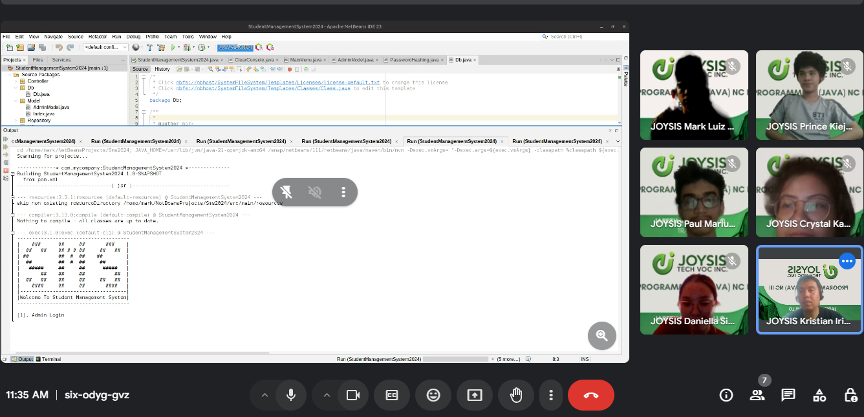
Daily Captured Work Progress
Day 3
Finalizing Database

Slide 28
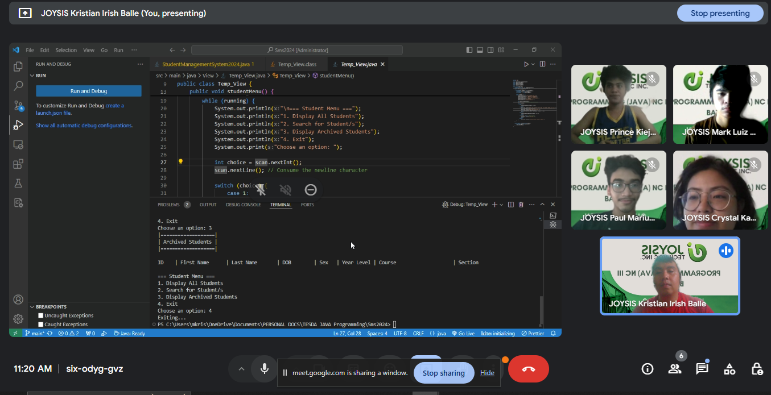
Daily Captured Work Progress
Day 4
Commence Program Creation

Slide 29
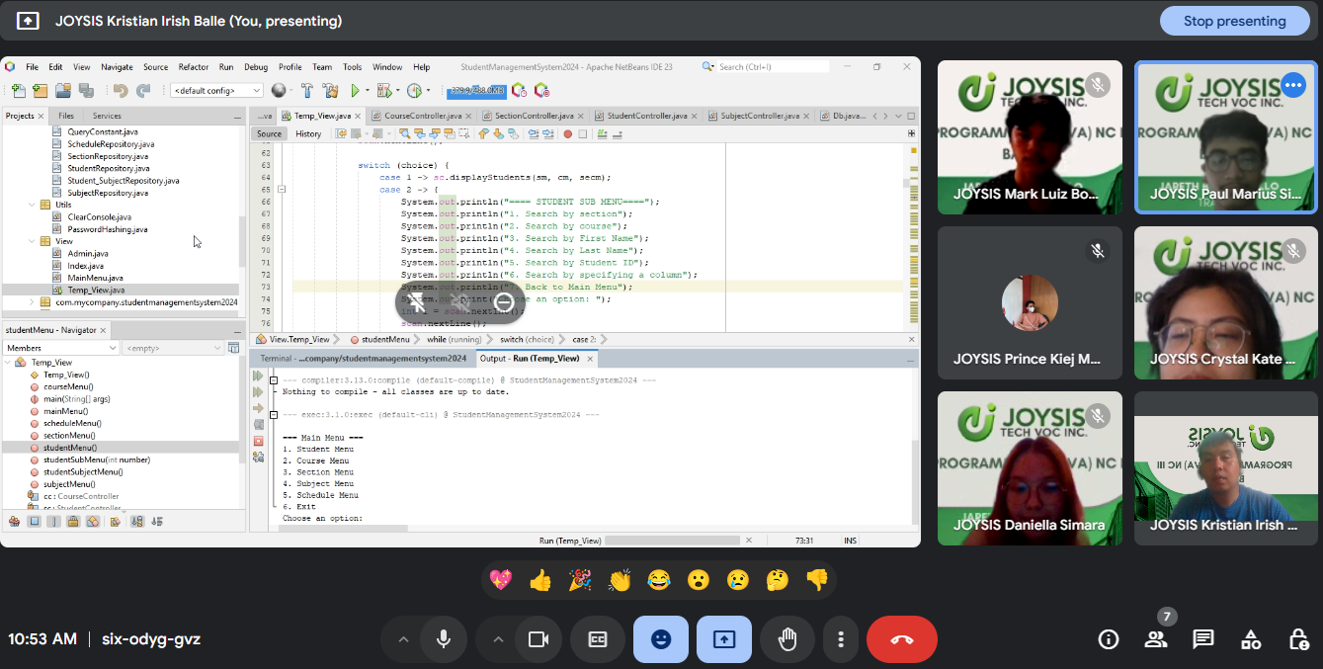
Daily Captured Work Progress
Day 5
Continuation of system development

Slide 30
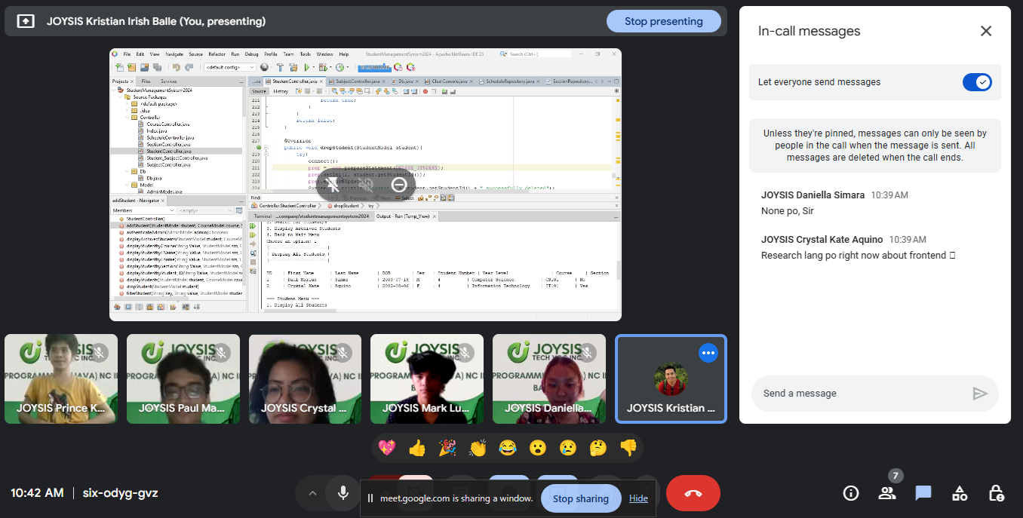
Daily Captured Work Progress
Day 6
Continuation of system development

Slide 31
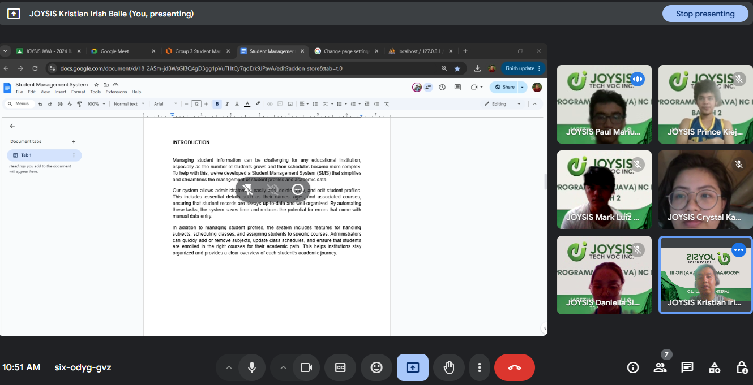
Daily Captured Work Progress
Day 7
Continuation of system development and
commencing documentation

Slide 32
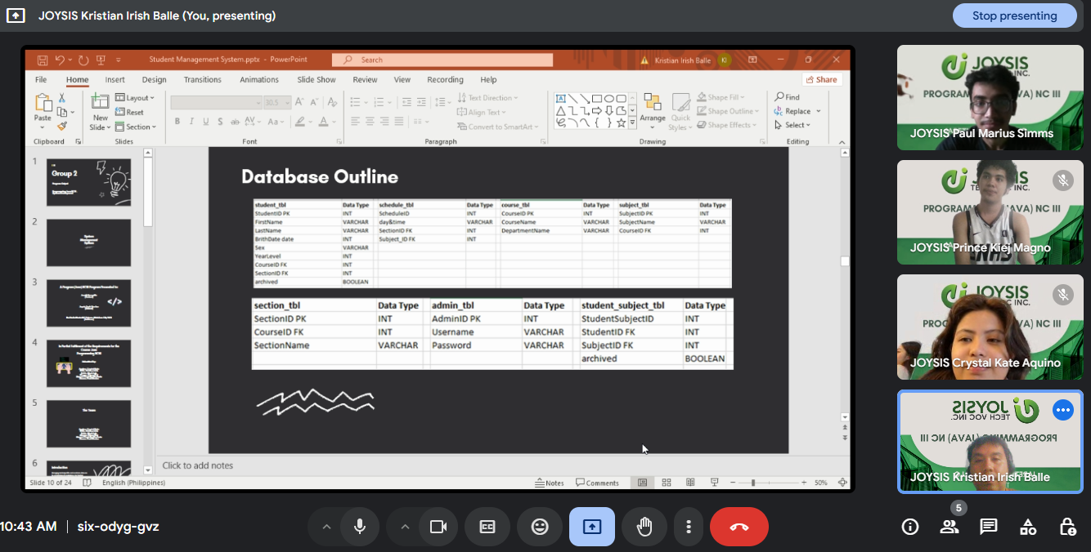
Daily Captured Work Progress
Day 8
Finalizing Program
Codes and
Documentaion

Slide 33

Thank You

